Slide 1
Group Members
Muhammad Sajjad Arif * - 31231
Muhammad Moaz Hassan - 31206
Muhammad Haris Ali - 31226
Supervisor : Engr. Wafa Qaiser Khan
Find this Presentation at : transit.pk/Presentation.pdf

Slide 2
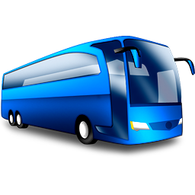
Transit Pakistan
The Smartest Way to Ride!

Slide 3
Objective
2 Million Commuters uses Public Transport in Karachi. [1]
Average commuter wasting around 20 minutes per day at Bus Stops.
Vast majority of these commuters have little or obscure information about other transport options.

Slide 4
Objective – Cont.
Less usage of Public Transport by Middle Upper Class. Why?
Too much private vehicles on Roads in rush hours.
No Resource where public can get access to Transport related information.

Slide 5
Motivation
We wanted to solve this issue with our Software Engineering Skills.
We are developing Transit Pakistan to enable people’s access to public transport information, empowering commuters to know about other options and increase the reach of urban transport.

Slide 6
Overview
We are trying to enhance our expertise specially in :
Web based API’s
MySQL & File System Databases
Mobile Application Development (Android)

Slide 7
Data Collection Research
We conducted visual research at different bus stop locations around Karachi to get to the problems faced by commuters.
Karachi Transport Authority to get Data for Vehicle Routes.
Google to Visualize these Locations & routes on Google Maps [2].

Slide 8
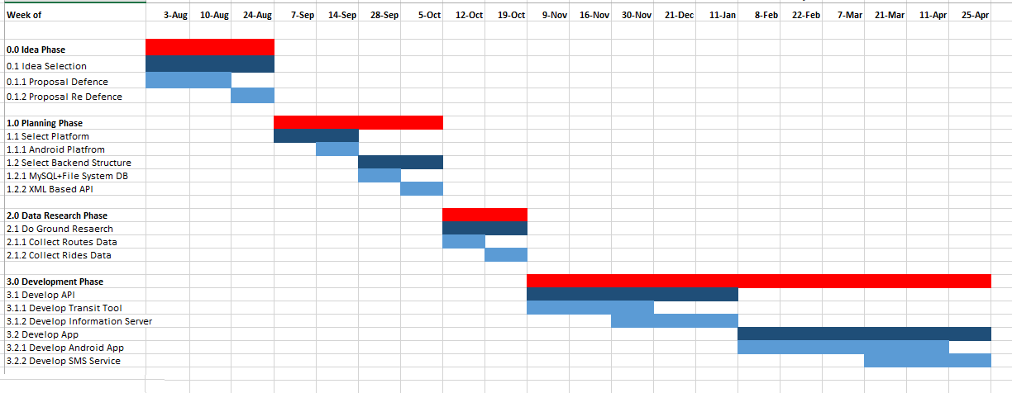
Gantt Chart
* Find Better View at : transit.pk/GanttChart.png

Slide 9
Deliverables
The main Deliverables of our FYP are
Transit Tool
Administrator Adds, Updates, Delete to the API from this tool.
Transit Pakistan API
The web based API that will be used by different software interfaces for queries.

Slide 10
Deliverables – Cont.
3. Android App
This is the main deliverable that will be used by end users as Android Mobile App.
4. SMS Service
Users without Smartphone will be using SMS services delivered by our project.

Slide 11
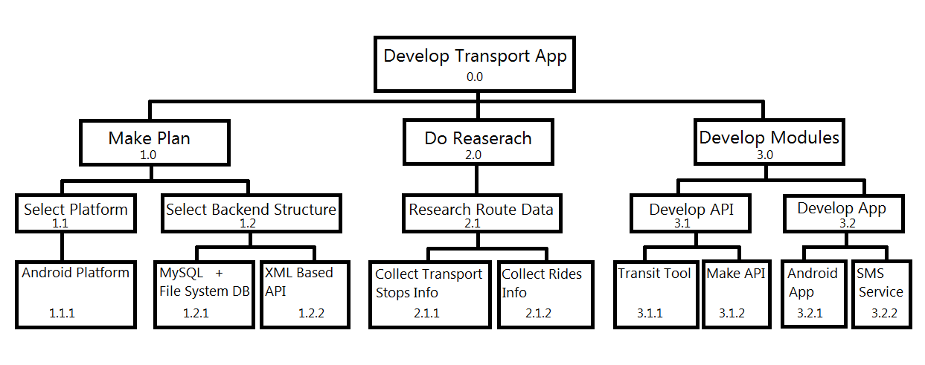
Work Breakdown Structure
* Find Better View at : transit.pk/WBS.png

Slide 12
Waterfall Model
Our FYP project is following an incremental development model such as waterfall model[3].
The development will be done in several phases with certain part of the project completed at the end of each phase.

Slide 13
Executed Work
We’ve completed two main phases of Project.
Data Collection Research
Transit Tool Development
API (Application Program Interface [4])

Slide 14
Executed Work – Cont.
Data Collection Research :
So far, we’ve collected data about 1200 Bus Stops location around Karachi.
The data includes different Ride options, Average Time & Cost - these Rides takes for each bus stop locations.
This amounts to 40% of Karachi.
* See the Live Map of Bus Stops: transit.pk/busstops/

Slide 15
Executed Work – Cont.
2. Transit Tool Development :
To make this Collected Data into usable Information format, we develop Transit Tool.
Transit Tool the Administrative Control Panel of our Project.
Admin can add, update or delete objects from API using Transit Tool.
Transit Tool developed using Visual Studio, C# & runs on local machine.

Slide 16
Executed Work – Cont.
3. API :
The main executed work of our Project is Transit Pakistan API.
API is developed on our online Information Processing Server using PHP with combination of MySQL & File System Database.
API is where our algorithms run to process queries & respond.

Slide 17
Remaining Work
Our Remaining Work includes
Gathering the Data about Remaining Bus Stop Locations & the Kind of Rides on those Routes.
Android App for End Users with Smartphones.
SMS Service for users without access to Smartphone.

Slide 18
References
[1] Dawn, “Karachi’s public transport on the verge of collapse: report,” - Dawn Pakistan, 23-Jan-2015. [Online]. Available at: http://www.dawn.com/news/1158772. [Accessed: 27-Jan-2016].
[2] G., “Google Maps,” Google Maps. [Online]. Available at: https://www.google.com/maps. [Accessed: 27-Jan-2016].
[3] “Waterfall Model,” Wikipedia. [Online]. Available at: https://en.wikipedia.org/wiki/waterfall_model. [Accessed: 27-Jan-2016].
[4] “API - application program interface,” What is Application Program Interface (API)? Webopedia. [Online]. Available at: http://www.webopedia.com/term/a/api.html. [Accessed: 27-Jan-2016].

